Slide 1

ACT in Primary Care Medicine
Large Scale Change through
Research, Teaching, and Training

Slide 2
THE QUESTIONS AND THE PANELISTS
I. Does embedding ACT in primary care support large scale behavior change?
Patti Robinson, Ph.D.
II. What are the key features for research studies on ACT interventions in the primary care setting?
Bridget R. Beachy, M. A.
David E. Bauman, M. A.
Melissa Baker, Ph.D.
III. What is the value of teaching ACT to medical providers and what methods work best?
Debra A. Gould, M.D., M.Ph.
Daniel C. Rosen, Ph.D

Slide 3
I. Does embedding ACT in primary care support large scale behavior change?
Notes:
Yes, but it depends on how you do it. So, I will very briefly explain why we need to embed ACT in PC and how to do it.

Slide 4


Patti Robinson, PhD
Mountainview Consulting Group, Inc
Mtnviewconsulting.com

Slide 5

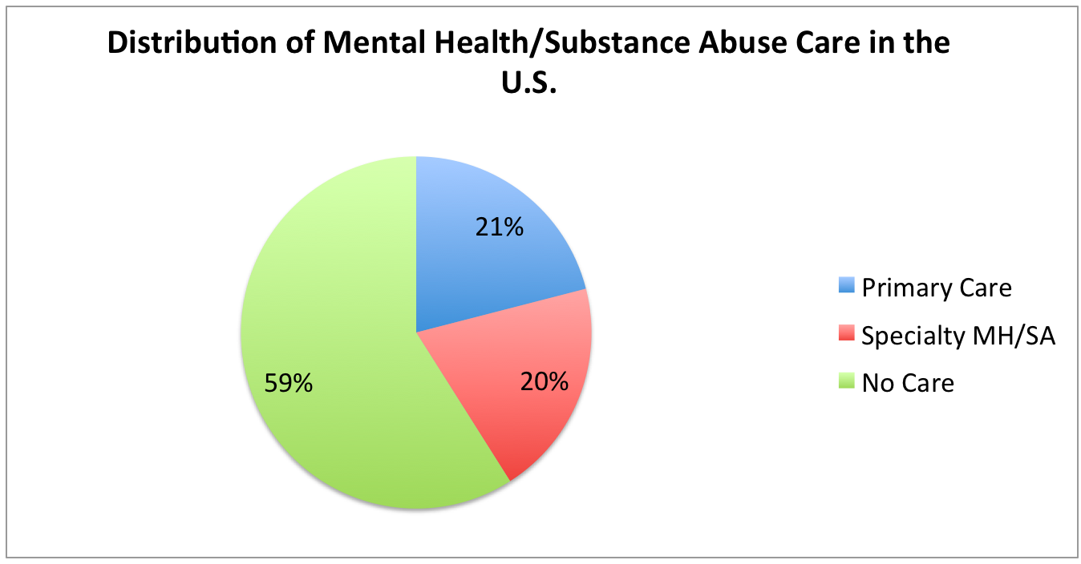
1 in 3 have diagnosable psychiatric disorder
at any given point
Only 20% receive care from specialty MH or SA
21% are treated in PC
59% SEEK NO CARE, AND
80% OF THESE WILL SEE A PCP IN A 12-MONTH PERIOD FOR SOMETHING.
93% OF CHILDREN WILL SEE A PCP IN A 12-MONTH PERIOD
Notes:
Around 30% of these Americans have a diagnosable psychiatric disorder at a given point in time (Kessler, Demler, Frank et al., 2005). Around 50% will experience a diagnosable disorder at some point (Kessler, Berglund, Demler et al., 2005).
only about 20% of those with a diagnosable problem receive care from a specialty MH or substance abuse (SA) clinic, while 21% are treated in PC and the majority, around 59%, receive no care at all (Wang, Lane, Olfson et al., 2005). These basic statistics upend the notion many have about where and how MH problems are treated in this country. Most people with problems seek no care, and many who do seek care simply go to the family doctor; few will ever see a therapist’s couch or comfy chair.
PCPs see everyone: children, acutely sucidal, they prescribe most of the psychotropic medications? PRIMARY CARE IS THE DE FACTO MH SYSTEM
59% SEEK NO CARE, AND
80% OF THESE WILL SEE A PCP IN A 12-MONTH PERIOD FOR SOMETHING.
93% OF CHILDREN WILL SEE A PCP IN A 12-MONTH PERIOD
PC address preventive health needs, as well as acute and chronic. Rates of psychological problems are increasing at the steepest rates among children and older adults. If you care about this, if you want a better future for children, I hope you will join us in PC because this is where we have a chance. This is where we can at least double our impact, but how? The devil is in the details.

Slide 6
Primary Care Behavioral Health (PCBH Model)
An approach to population-based mental health clinical care
That is simultaneously
  Co-located
  Collaborative
  Integrated within the primary care clinic
It is a consultant model; not a psychotherapy model
Will meet the needs of 90% of the people in PC
Notes:
You will need a tested model to serve as a platform and this model is the Primary Care Behavioral Health model.

Slide 7

I am a Behavioral Health Consultant (BHC).
Brief Interventions
  Directive, 15-30 minute visits
  Most same day of medical visit
  Consultative role
  Assess functioning
  Focus on target problem
  Develop behavior change plan, team supports
  Usually complete episode in 4 or less visits
  Continuity visits for more at risk patients (1:1, T/C)
  Workshops, classes (10-20%)
BHC
Notes:
Patti
It starts most often with PCC referral, but patients may also self-refer (if they are patients at the clinic).
Then, the BHC flow continues. . .

Slide 8
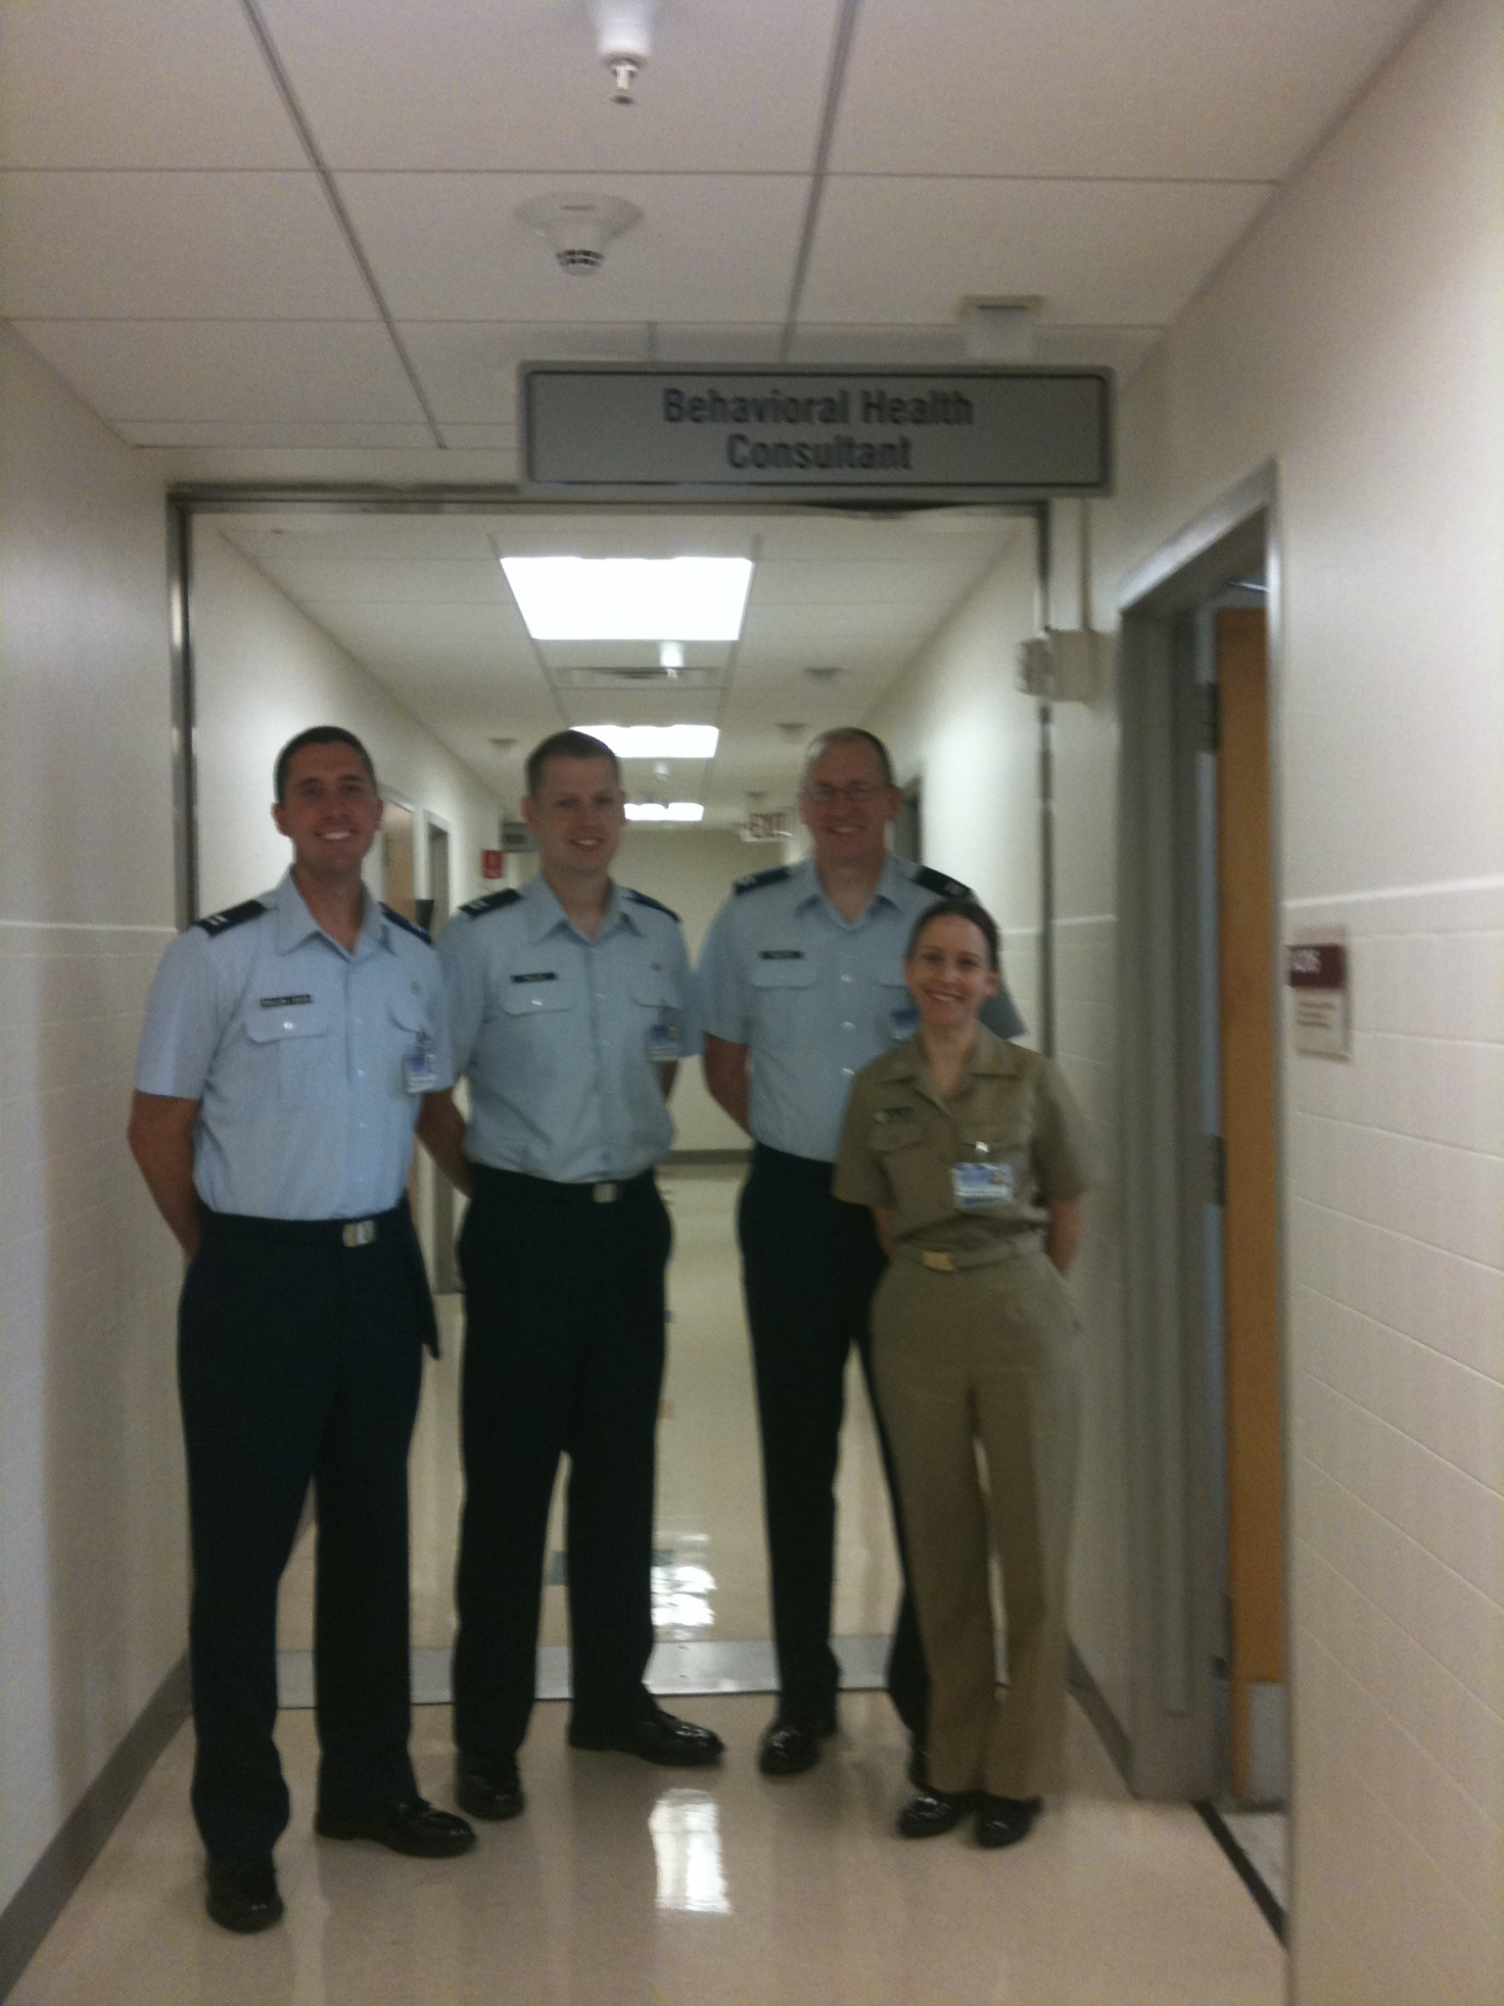
I am a Behavioral Health Consultant (BHC).
PCBH Pathways
  Targets a patient population that has high impact (by numbers or by way of presentation)
  Applies the evidence for the care of the targeted population
  Respectful of local resources
  Seeks to improve efficiencies
  Measurement of outcomes planned
BHC

Slide 9
The BHC Bottom Line
Patients are not “broken”; trapped
Curious about the function of symptoms; how do they function in a patient’s life (fatigue as a reason to avoid activities)
Curious about patient’s interaction between patient’s internal (mental) and external (environmental) contexts
“Symptoms” signal imbalance in the internal or external contexts, often a part of rule driven avoidance

Slide 10
Maladaptive behaviors are learned and maintained by external and internal contextual factors
Self “as perspective” is a separate and powerful context for behavior change
Values connection catalyze appetitive control
Many maladaptive behaviors occur as a result of skill deficits
Direct behavior change is the most powerful form of human learning
Notes:
Patti

Slide 11


PCBH Works!
Functioning and symptoms improve
Rates of using coping skills improve
Stable gains over 2 year period
Better social integration
Notes:
It works and ACT specific evidence is growing.

Slide 12
ACT Evidence
Better diabetes management and significant improvement in
Hemoglobin A1C (Gregg, et al, 2007)
Improved rates of smoking cessation (Gifford, et al., 2004)
Chronic pain and disability behavior improvements
(McCracken et al., 2004)
Reduced seizures and improved QOL (Lundgren, et al., 2008)
Depressed patients (Zettle & Hayes, 1986) and
polysubstance abusing methadone-maintained opiate addicts (Hayes, et al., 2004)
Better than usual care or waiting lists and as effective as CB or other psychotherapies in tx of many traditional mental health (Powers, et al, 2009), including anxiety (Hayes, et al, 2006)
Is Growing
Notes:
Hand off to Bridget

Slide 13
II. What are the key features for research studies on ACT interventions in the primary care setting?

Slide 14
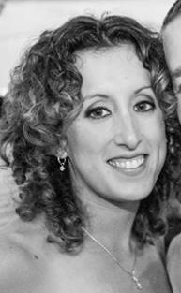
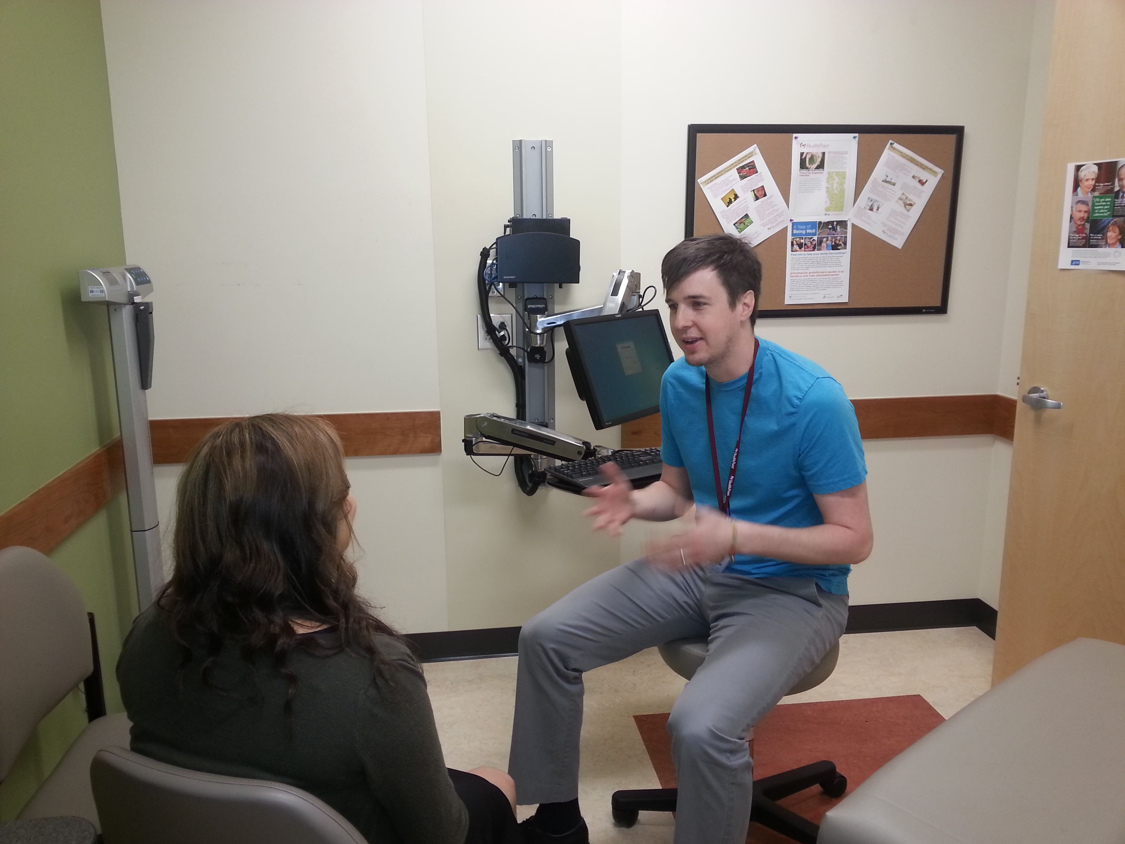

Bridget Beachy, PsyD – SOON!, Behavioral Health Consultant, Central Washington Family Medicine Clinic (CWFMC) Yakima
David Bauman, PsyD – SOON!, Behavioral Health Consultant, Central Washington Family Medicine Clinic (CWFMC) Yakima
Melissa Baker, PhD- Behavioral Health Consultant, Bothell HealthPoint

Slide 15

ACT Research in PCBH
Characteristics of ACT research in PCBH
  Trident perspective
  Essential features
ACT in PCBH for specific concerns
  Anxiety
  Weight
  Hypertension
  Flexibility within provider’s stress levels
Notes:
Unique Obstacles

Slide 16
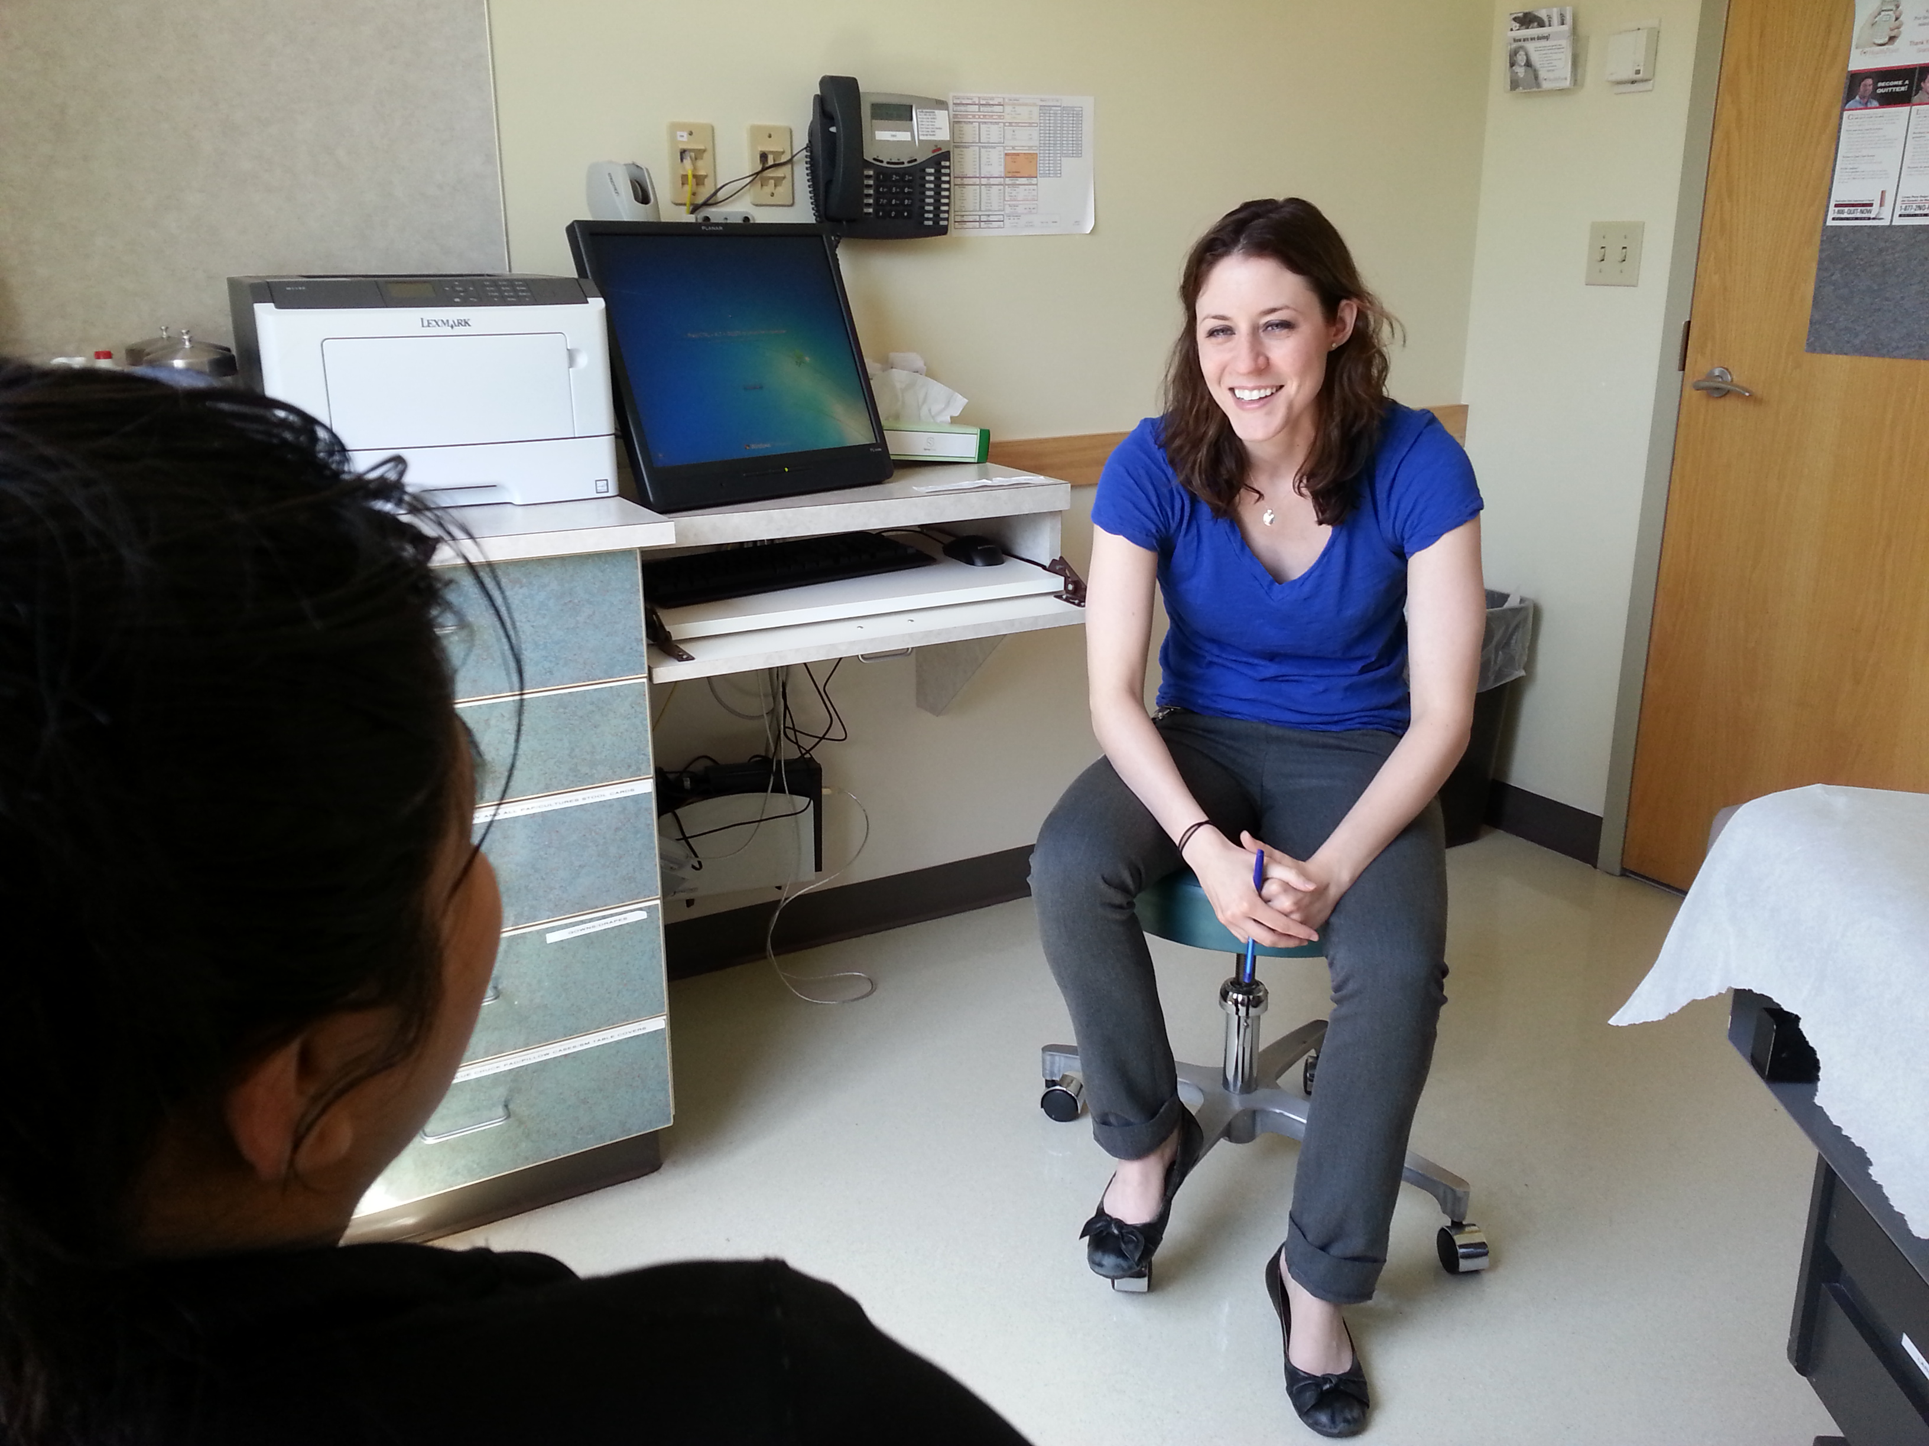
“Trident” Approach to Research
Clinical Interventions
Training/Teaching Holistic Health
Assisting PCPs
Notes:
“Trident” approach
Assessing brief clinical interventions
Training and teaching medical providers on mind-body connection (ACT philosophy, ACEs study, panic attacks, etc.)
Assisting overworked PCPs to reduce burden

Slide 17



Essential Features of ACT Research in PCBH
1) Bring your “A” game
2) Transdiagnostic
3) Chronic diseases
4) Symptom reduction vs. functional restoration
5) Multiple obstacles
Notes:
Front loading the first session
Comorbid medical, behavioral, mental and substance abuse problems
1st line treatments are behavior change (Pre-diabetes, hypertension, etc.)
DUKE-Health Profile, VLQ, WHOQOL-BREF, AAQ-II
Brief
Process measures just as important as outcome measures

Slide 18
Unique Obstacles
1) Messy
2) Brief
3) Variety
4) Controlled trials
5) Provider training
Notes:
1. Confounds (e.g., medications, psychosocial stressors, etc.)
Internal vs. external validity
2.
3. Don’t know what is walking into the exam room
Specific ACT protocol vs. ACT lens
Treatment fidelity
4. Move beyond feasibility and within group changes
5. Training in ACT essential, as well as PCBH model
Exciting area of research

Slide 19
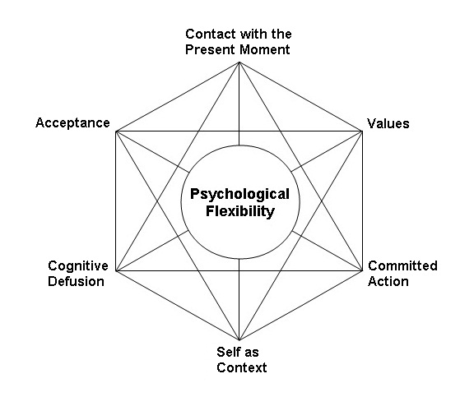
Common Themes
1) Brief protocol, measures
2) Spirit of Hexa-flex
a) FACT Pillars
3) Matrix
4) Flexible scheduling
5) Specific concern + improve overall functioning
Notes:
15-30 minute visits, brief measures (AAQ-II, DUKE, etc.)
2) Pillars - Open (e.g., willingness), aware (e.g., mindfulness) and engaged (e.g., committed action)
3) Matrix
4) 3 – 4 visits, occurring every 2 – 4 weeks, Flexible schedule, real life application
5) components vs. structured protocols

Slide 20
Recent Studies
ACT and Anxiety
ACT and Weight
ACT and Hypertension
Provider study regarding flexibility and stress

Slide 21
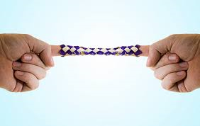
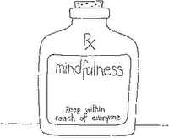
ACT and Anxiety
13 participants
  11 completed treatment
3 brief sessions
Measures:
  Outcomes: WHOQOL-BREF, VLQ, GAD-7, BAI
  Process: VLQ, AAQ-II, MAAS
Notes:
ACT and anxiety
13 participants
Recruited from medical center that served uninsured/underserved
Only exclusion criteria: psychotic disorders
11 completed three session protocol
Brief intervention (25-30 minutes, occurring every two weeks; 15.5 days between Session I and II; 18.8 days between Session II and III; 34.3 days total)
Protocol focused on mindfulness, acceptance, and committed action
Measures
Quality of Life: WHOQOL-BREF (26-item measure) VLQ
Anxiety: GAD-7 and BAI
Process: AAQ-II, VLQ, MAAS

Slide 22

ACT and
Anxiety
Results
  Outcome measures
    WHOQOL-BREF
      Psychological Composite: 12.54 improvement (p = .020)
      Total Composite: 11 improvement (p = .013)
    VLQ: 17.62 improvement (p = .013)
    GAD-7: 5.82 improvement (p = .025)
    BAI: 7.96 improvement (p = .021)
  Process measures
    AAQ-II: 8.64 improvement (p = .054)
    MAAS: 4.28 improvement (p = .365)
Notes:
ACT and anxiety results
WHOQOL-BREF
Significant (t(10) = -2.751, p = .020) improvements in Psychological composite score by end of treatment. Overall, 12.54 point increase
Significant (t(10) = -2.994, p = .013) improvements in Total composite score by end of treatment. Overall, 11 point increase
VLQ
Significant (t(10) = -2.996, p = .013) improvements by end of treatment. Overall, 17.62 point increase
GAD-7
Significant (t(10) = 2.632, p = .025) improvements by end of treatment. Overall, 5.82 point decrease
BAI
Significant (t(10) = 2.728, p = .021) improvements by end of treatment. Overall, 7.96 point decrease
Process measures
AAQ-II
Approaching significant (t(10) = 2.184, p = .054) improvement by end of treatment. Overall, 8.64 point decrease.
MAAS
4.28 point improvement, but not significant (t(10) = -.950, p = .365)

Slide 23
ACT and Anxiety

Slide 24

ACT and Anxiety
Implications:
  Feasible
  Improve QOL and anxiety
  Components of protocol
  Limitations
  Encouraging!
Notes:
Conclusions
Suggest ACT can be adapted to brief visits for anxiety that are feasible within PCBH model
Can improve quality of life, while also reducing anxiety
Components of protocol moved (except for MAAS) and were associated with outcomes
Obvious limitations due to sample size, no control group, only one provider and clinic, no long-term follow-up
Encouraging, nonetheless

Slide 25
ACT and Weight Study
15 participants enrolled, 12 attended at least one session, 11 became completers. n=11
No control group due to exploratory nature
4 brief sessions, one every 1-4 weeks
BMI > 25.0, No exclusions
Measures: AAQ-W, WHOQOL-BREF, MAAS, BMI
Demographics – Complex
  No college graduates
  10/11 unemployed
  11/11 chronic medical conditions, took daily prescriptions, 9 diagnosed with depression
  Average BMI, M=45.9 (SD=10.3)
Notes:
Completers - finished at least 3 our of 4 sessions; 9 women, 2 men
Brief visits - (i.e. 25 – 30 min)

Slide 26
ACT Weight Results
* p < .05; ** p < .01
Notes:
The lower the better.
Dropped from 93.64 at 1st visit to 79.7 at 2nd to 78.82 at 3rd to 73.22 at 4th

Slide 27
ACT Weight Correlations
AAQ-W WHOQOL-BREF BMI
MAAS -.724** .564** -.263
AAQ-W -.617** .399*
WHOQOL-BREF -.350*
*p < .05
**p < .01

Slide 28

ACT and Hypertension
  Session 1- Brief Psychoeducation, Goal Setting- VALUES, Brief mindfulness breathing exercise
  Session 2- Acceptance
  Session 3- Review
    ** Modification of goal as needed Session #2 and #3
Notes:
Session 1- Mindfulness of breath, 3 senses
Session 2-(Chinese finger trap, Unwelcomed party guest, Observation of TEAMS, Connection of acceptance to breath, Brief mindfulness exercise (leaves on a stream, clouds)

Slide 29

ACT and Hypertension
    Measures
      DUKE Health Profile
      AAQ-II
      MAAS
      VLQ
      Blood Pressure
      Weight
      CDS-12
    Additional data gather:
      Weight, Height, Age, Gender, Chronic Diseases, Mental Health Diagnoses, Language
    Population
      51 patients in treatment group
Notes:
51 total participants across four clinics
38 provided two data points*
36 provided three data points*
Common Co-occuring Health Conditions- Obesity, Chronic Pain, Migraines, Thyroid
Common Co-occuring Mental Health Conditions- Anxiety, Depression
Control Group

Slide 30

ACT and Hypertension
  Initial results
    13.9 point systolic reduction at data point 2 (p < .000)
    12.56 point systolic reduction at data point 3 (p = .003)
      * A lot more data to analyze, but encouraging!
Notes:
Systolic BP (M = 134.79, SD = 16.5) was significantly lower (t(37) = 4.362, p < .000) than baseline systolic BP (M = 147.87, SD = 20.374).
Between data point 3 and baseline:
Systolic BP (M = 137.69, SD = 18.7) was significantly lower (t(35) = 3.146, p = .003) than baseline systolic BP (M = 150.25, SD = 19.2).

Slide 31
Provider Study
    Overview
      Is flexibility related to provider work-related stress?
      Ongoing project! Contact if interested in helping get survey out to medical clinics!
    Measures
      Primary Care Provider – Stress Checklist*
      Primary Care Provider – AAQ*
      AAQ-II
      BH satisfaction survey (O’Donahue)
  *Robinson, Gould, & Strosahl, (2010). Real Behavior Change in Primary Care.
Notes:
A survey study evaluating Primary Care Provider experience of
Stress
Psychological flexibility
Behavioral Health utilization
Hoping to expand study, please contact if medical clinic would be interested

Slide 32
Provider Study
    Results
      50 participants completed survey
      PCP-SC and PCP-AAQ
        Strong negative correlation (r = -.52; p < .01)
          PCP-AAQ accounted for 27% of PCP-SC variance
      PCP-SC and AAQ-II*
        Strong positive correlation (r = .60; p < .01)
    Next steps
      Expanding project
      Develop training to improve provider’s flexibility and assess impact on stress
Notes:
n = 50
The PCP-SC had a significant (p < .01) strong negative correlation (r = -.52) with the PCP-AAQ, indicating that as one increases their flexibility, their stress levels decrease.
The PCP-SC also had a significant (p < .01) strong positive correlation (r = .60) with the AAQ-II*, which reaffirms the previous notion that as flexibility increases, stress levels decrease.
PCP-AAQ accounted for 27% of the PCP-SC’s variance (p < .000).
Next steps
Expanding project to increase sample size
Develop training to improve provider’s flexibility and assess impact on stress

Slide 33
III. What is the value of teaching ACT to medical providers and what methods work best?

Slide 34

Debra A. Gould MD, MPH
Central Washington Family Medicine Residency Program,
Associate Clinical Professor, University of Washington, Seattle

Slide 35
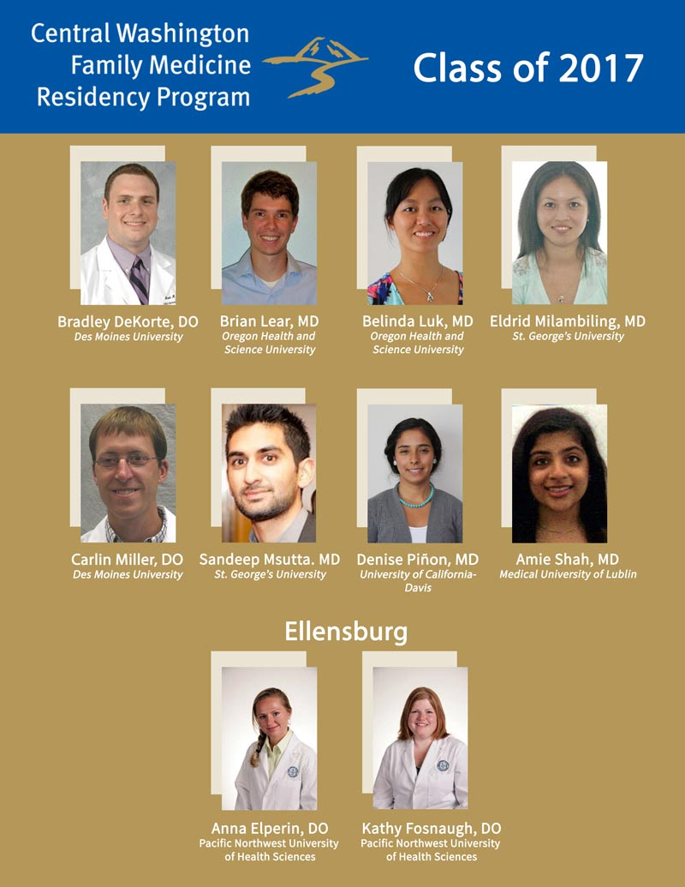
Teaching ACT to Medical Providers?
3 Years
MDs, DOs
Biopsychosocial approach
Full Spectrum Care
Relationships over a Lifetime!
FQHC

Slide 36


Teaching ACT to Medical Providers?
Patients
Clinician Resiliency
Notes:
Learn the overall model, specific concepts and applications to patient care and self-care to help build resiliency and prevent burn-out.

Slide 37
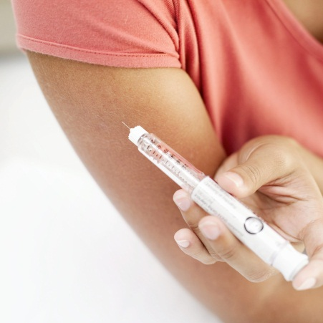

Teaching ACT to Medical Providers?
Trans-Diagnostic
Focus on Function
Adaptable to Primary Care
Need more research!!!

Slide 38
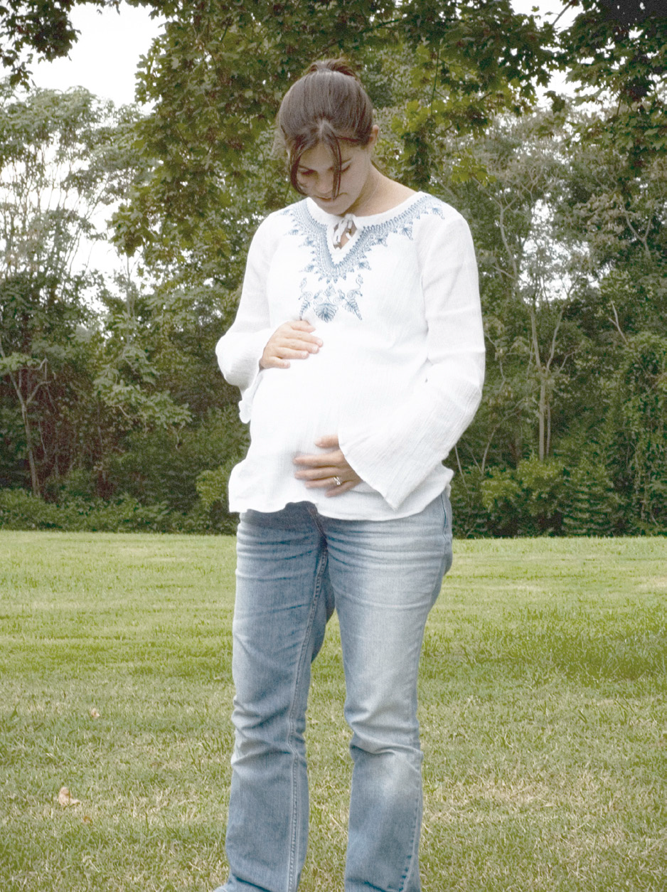
How do we teach ACT ?
Wellness Workshop
(twice a year)
Rotation Behavioral Health Faculty (R1, R2, R3)
  Psychosocial Medicine
  Ambulatory Family Medicine
Precepting in Clinic
Community Involvement
GRADS Program
Notes:
GRADS is a program for pregnant students and young parents (both male and female)to learn practical parenting skills, stay in school through graduation, and prepare for employment after high school.

Slide 39

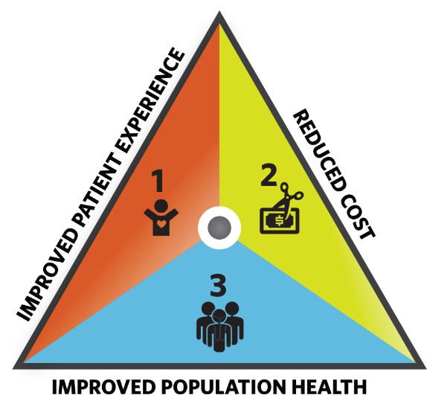





Dissemination
Collaborative Family
Health Association
Cherry Hill Family Medicine
Residency Program
Family Medicine Residency
Kasson, Minnesota
Oregon

Slide 40
Daniel C. Rosen, Ph.D.
Associate Professor, Counseling & Health Psychology
Bastyr University

Slide 41
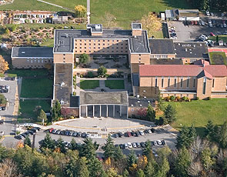

Bastyr University
Kenmore, WAre, WA
Seattle, WA

Slide 42
What is Naturopathic Medicine?
  “Naturopathic medicine is a distinct primary health care profession, emphasizing prevention, treatment, and optimal health through the use of therapeutic methods and substances that encourage individuals’ inherent self-healing process.” (AANP, 2014)
  Naturopathic medicine emphasizes finding and treating the cause of illness/disease over symptom reduction.
  17 states, Washington DC, and the U.S. territories of Puerto Rico and the Virgin Islands have licensing (or regulation laws) for naturopathic doctors.

Slide 43
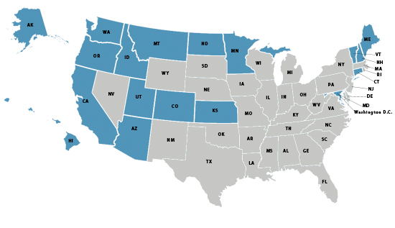
Licensed States & Territories

Slide 44

Principles of Naturopathic Medicine
First Do No Harm - primum non nocere
The Healing Power of Nature - vis medicatrix naturae
Discover and Treat the Cause - tolle causam
Treat the Whole Person - tolle totum
The Physician is a Teacher - docere
Prevention is the best "cure" - praevenire

Slide 45
Therapeutic Modality Training (credits)
Modality | Allopathic MD | Naturopathic ND
Nutrition | 0-2 | 12
Counseling | 0-5 | 14
Structural Adjustment | 0 | 11.5
Botanical Medicine | 0 | 11
Pharmacology | 8 | 5
Homeopathy | 0 | 8
Figures compare number of credits for each area of study between
Bastyr University School of Naturopathic Medicine (ND) and
University of Washington School of Medicine (MD)

Slide 46

How do we teach ACT?
Academic Course | ACT Infusion
Therapeutic Alliance I | Mindfulness (for Two)
Therapeutic Alliance II | Cognitive Defusion; Acceptance; Hayes on Prejudice
Fundamental Counseling Skills | Values; Committed Action

Slide 47

How do we teach ACT?
Academic Course | ACT Infusion
Counseling Theories & Interventions I | Explicit Introduction to Model; Readings & Videos
Psychological Assessment | Focus on Function
Counseling Theories & Interventions II | Focus on Mindfulness & Acceptance
Addictions | Values; Committed Action; Mindfulness

Slide 48
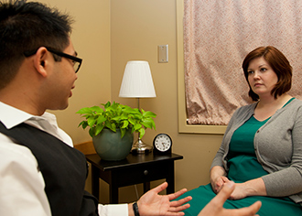
How do we teach ACT?
Clinical Rotation | ACT Infusion
Counseling Shift | Applying ACT
Advanced Counseling Shift: Behavioral Medicine | Real Behavior Change in Primary Care

Slide 49
Questions, Comments
I. Embedding ACT in primary care to support large scale behavior change
Patti Robinson, Ph.D.
II. Key features for research studies on ACT in primary care
Bridget R. Beachy, M. A.
David E. Bauman< M. A.
Melissa Baker, Ph.D.
III. The value of teaching ACT to medical providers and what methods work best
Debra A. Gould, M.D., M.Ph.
Daniel C. Rosen, Ph.D

